Slide 1
zekeLabs
Learning made Simpler ! www.zekeLabs.com

Slide 2
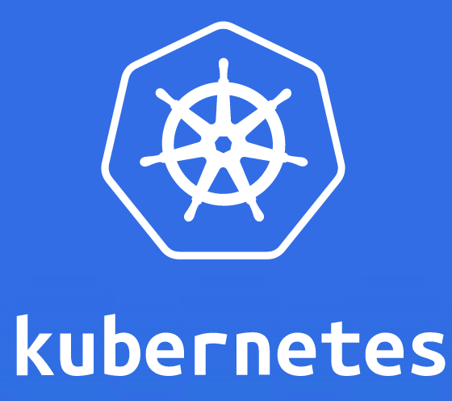

Slide 3
Kubernetes : Volumes
info@zekeLabs.com | www.zekeLabs.com | +91 8095465880

Slide 4
Volumes
Kubernetes volumes are a component of a pod and are thus defined in the pod’s specification, like containers.
They are NOT a standalone Kubernetes object and cannot be created or deleted on their own.
A volume is available to all containers in the pod, but it must be mounted in each container that needs to access it.
In each container, you can mount the volume in any location of its filesystem.
Volume’s contents will persist across container restarts.
A volume is created when the pod is started and is destroyed when the pod is deleted.

Slide 5
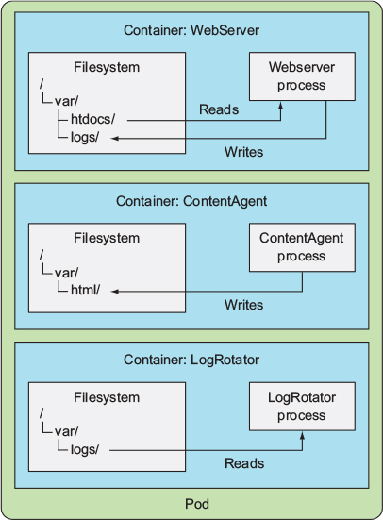
Three containers of the same pod without shared storage

Slide 6
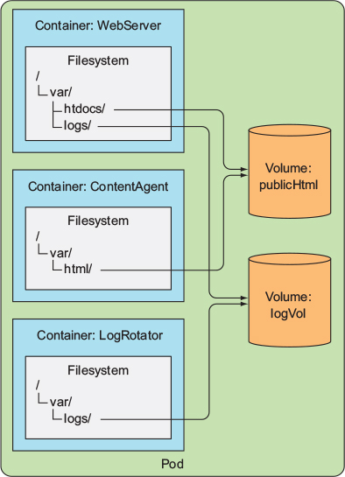
Three containers sharing two volumes mounted at various mount paths

Slide 7
Storage types
emptyDir: A simple empty directory used for storing transient data.
hostPath: Used for mounting directories from the worker node’s filesystem into the pod.
gitRepo: A volume initialized by checking out the contents of a Git repository.
Persistent type:
nfs: An NFS share mounted into the pod.
cloud provider-specific storage: gcePersistentDisk, awsElasticBlockStore, azureDisk.
configMap, secret. Used to expose certain Kubernetes resources and information to the pod.
persistentVolumeClaim: A way to use a pre- or dynamically provisioned persistent storage
other types of network storage: cinder, cephfs, iscsi, flocker, glusterfs, quobyte, rbd, flexVolume, vsphere-Volume, photonPersistentDisk, scaleIO

Slide 8
Fortune telling project
Use Nginx as the web server and the UNIX fortune command to generate the HTML content.
The fortune command prints out a random quote every time you run it.
A script fortuneloop.sh invokes the fortune command every 10 seconds and stores its output in index.html.
Using emptyDir

Slide 9
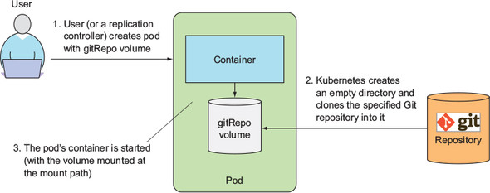
Gitrepo Volume
A gitRepo volume is an emptyDir volume initially populated with the contents of a Git repository.

Slide 10
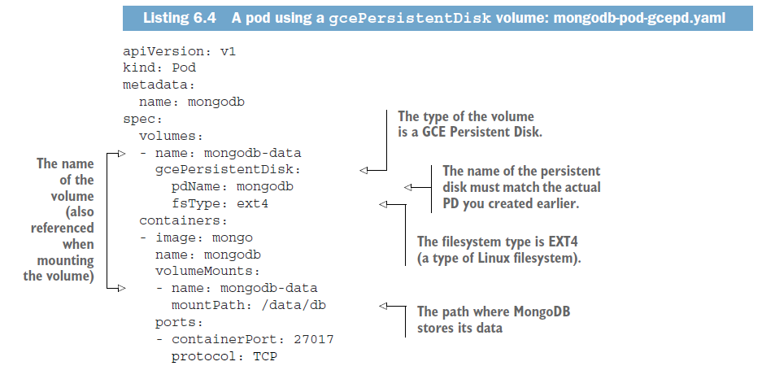
cloud provider-specific storage: gcePersistentDisk, awsElasticBlockStore, azureDisk.

Slide 11
Persistent Volume
A PersistentVolume (PV) is a piece of storage in the cluster that has been provisioned by an administrator. It is a resource in the cluster just like a node is a cluster resource.
PVs are volume plugins like Volumes, but have a lifecycle independent of any individual pod that uses the PV.
This API object captures the details of the implementation of the storage, be that NFS, iSCSI, or a cloud-provider-specific storage system.

Slide 12
Persistent Volume Claim
A PersistentVolumeClaim (PVC) is a request for storage by a user.
Similar to Pods, as in :
Pods consume node resources and PVCs consume PV resources.
Pods can request specific levels of resources (CPU and Memory), Claims can request specific size and access modes (e.g., can be mounted once read/write or many times read-only).

Slide 13
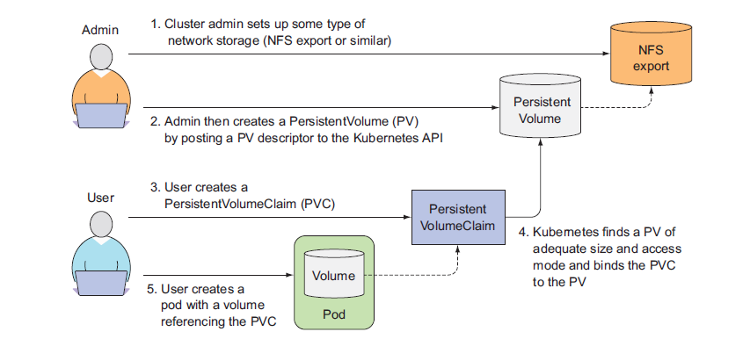
Provisioning of PV and PVC

Slide 14
THANK YOU
Let us know how can we help your organization to Upskill the employees to stay updated in the ever-evolving IT Industry.
Get in touch:
www.zekeLabs.com | +91-8095465880 | info@zekeLabs.com
Visit : www.zekeLabs.com for more details

